Slide 1
Employee Data Analysis using Excel
STUDENT NAME: Leka C
REGISTER NO: 312216979
DEPARTMENT: B.com(General)
COLLEGE: Shri Krishanswamy College for women

Slide 2
PROJECT TITLE
VISUALIZING EMPLOYEE ATTENDANCE TRENDS AND EXCEL CHARTS

Slide 3


AGENDA
Problem Statement
Project Overview
End Users
Our Solution and Proposition
Dataset Description
Modelling Approach
Results and Discussion
Conclusion
3/21/2024 Annual Review

Slide 4

PROBLEM STATEMENT
*Employee Information: Employee ID, Name, Department, Designation. *Attendance Data: Date, Status (Present, Absent, Late, Leave), Hours Worked, Reason for Absence (if any). *Time Period: Daily, Weekly, Monthly, or Yearly attendance data.
*Data Preparation: Ensure that the data is clean, consistent, and formatted correctly in Excel.
*Analysis: Identify patterns such as frequent absenteeism on specific days. Compare attendance across departments or teams.

Slide 5

PROJECT OVERVIEW
The objective of this project is to analyze and visualize employee attendance data to identify trends, patterns, and anomalies that can inform HR policies and improve workforce management. The analysis will leverage Excel charts to provide clear, actionable insights into attendance behaviors across the organization.

Slide 6

WHO ARE THE END USERS?
*HR Department
*Department Managers/Supervisors
*Senior Management/Executives
*Payroll and Finance Teams
*Employee Relations and Compliance Teams
*Employees (Optional – Limited View)

Slide 7

OUR SOLUTION AND ITS VALUE PROPOSITION
Solution Overview:
Our solution provides a comprehensive Excel-based platform that visualizes employee attendance trends using various charts and dashboards.
Value Proposition:
*Enhanced Decision-making
*Improved Attendance Management
*Operational Efficiency
*Increased Transparency
*Cost Savings

Slide 8
Dataset Description
*The dataset for visualizing employee attendance trends with Excel charts includes detailed records capturing various aspects of attendance behavior. It comprises employee information such as Employee ID, Name, Department, Designation, and Joining Date, which helps in identifying attendance patterns across different teams and roles. The core of the dataset is the attendance records, which include the Date, Status.
For Example: Present, Absent, Late, On Leave, In-Time, Out-Time, and Hours Worked, providing a daily snapshot of employee presence and punctuality

Slide 9

THE "WOW" IN OUR SOLUTION
Our Excel-based solution for visualizing employee attendance trends stands out with its impactful, user-friendly, and insightful features that go beyond standard reporting, delivering a ‘WOW’ factor that elevates attendance management to the next level.
3/21/2024 Annual Review
9

Slide 10
MODELLING
1.Data Structuring and Preparation:
*Data Import and Cleaning
*Dataset Layout
*Employee ID
*Employee Name
*Department
*In-Time/Out-Time
*Hours Worked
2.Metrics Calculation:
*Total Days Present
*Total Days Absent
*Attendance Percentage
3.Visualization with Excel Charts:
*Line Charts
*Bar/Column Charts
*Pie Charts
10

Slide 11
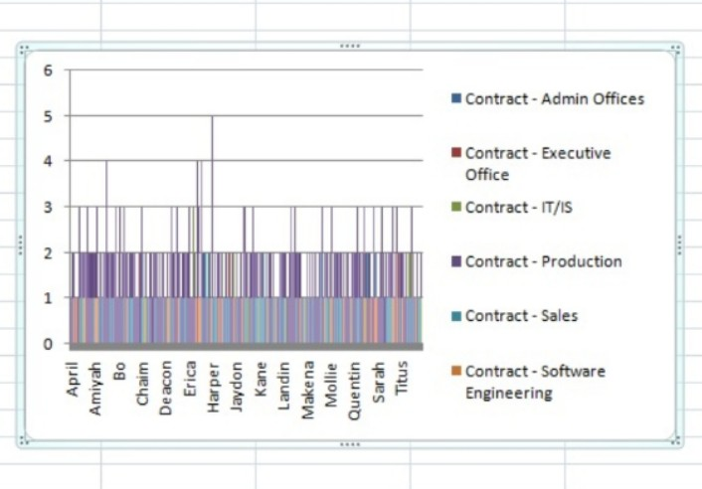
RESULTS
11

Slide 12
conclusion
Visualizing employee attendance trends with Excel charts turns raw attendance data into actionable insights, enhancing decision-making and improving workforce management. Through interactive dashboards, dynamic charts, and predictive analysis, this solution empowers HR and management to identify trends, address absenteeism, and optimize overall attendance. It's a powerful, cost-effective tool that brings clarity, accountability, and strategic value to attendance management.

